Slide 1

This is angry Matt!
He is a cab driver and only made $45 yesterday from the entire day!

Slide 2

Objective:
Exploration and analysis of coordinates of NYC taxi trips to local census tracts, neighborhoods and other external factors to find out the predictors of daily profits.
User Case:
Taxi Drivers’ Financial Crisis Due to Hit of UBER
“I want to know WHAT ARE THE factors that INFLUENCE MY PROFITS so that I can strategically earn MORE!”
Notes:
Every taxi has to pay hundreds even thousands of dollars for a New York City-issued license, known as a taxi medallion. Now the value of these medallions is taking a huge hit as Uber cars flood the city.There are 13,000 yellow taxis in New York City. But the competition from 20,000 Uber cars has cut sharply into the taxis' customer base. The plunge in medallion values has created a financial crisis for taxi owners. Matt and other cab drivers are desperately in need of help to know what are the factors that influence their daily profit so that they can strategically and effectively compete with Uber and earn more money. Would that be the pickup location? The weather? The payment method? Tip amount?
http://money.cnn.com/2015/07/21/news/companies/nyc-yellow-taxi-uber/

Slide 3

We, the fearless Entrepreneur- sheep team will reach out to help him

Slide 4
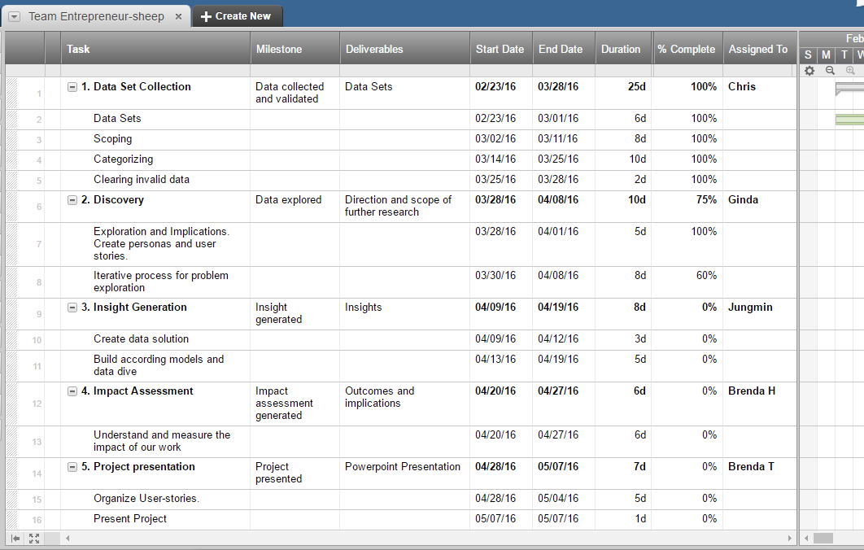
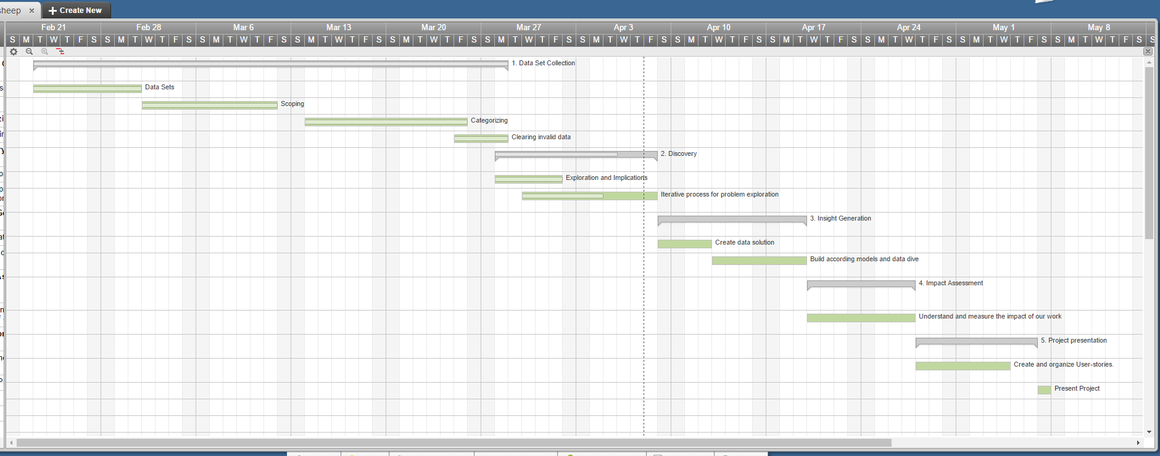
PROPOSED METHODOLOGY
PROJECT PLAN
CoNVO
● Context
Cab drivers will benefit from our analysis by knowing where and when to drive and other techniques to make more fares
Taxi Company will be interested in the results since they will know where to allocate the cabs and resources
● Need
How is every trip coordinated to local census tracts, neighborhoods and other external factors?
What are the stories and meaning from the data?
● Vision
Underlying coordinates
Powerful Predictors
Story Telling
● Outcomes
Regain competitiveness against Uber and other car services in the market.

Slide 5



DATA COLLECTION & CLEANING
DATASET : Yellow Taxi Trip Records, Weather Data, Census Data
PROVIDERS :
2009 - 2015
2.5Gb / Month
15GB
SAMPLE: May 2015
10,000 rows
Delete the irrelevant data
Latitude - Longitude -> Zipcode
Notes:
This dataset includes trip records from all trips completed in yellow and green taxis in NYC in 2014 and select months of 2015. Records include fields capturing pick-up and drop-off dates/times, pick-up and drop-off locations, trip distances, itemized fares, rate types, payment types, and driver-reported passenger counts. The data used in the attached datasets were collected and provided to the NYC Taxi and Limousine Commission (TLC) by technology providers authorized under the Taxicab & Livery Passenger Enhancement Programs (TPEP/LPEP). The trip data was not created by the TLC, and TLC makes no representations as to the accuracy of these data.

Slide 6
Our Key-Variables
Pick-up Location
Longitude, Latitude
Pick-up Time
Total Fare Amount
Tip Amount
Weather Condition such as wind speed, precipitation, maximum temperature and minimum temperature.
Demographic condition such as number of population, percentage of white, asian, etc.

Slide 7
So what does that mean for
angry Matt?

Slide 8
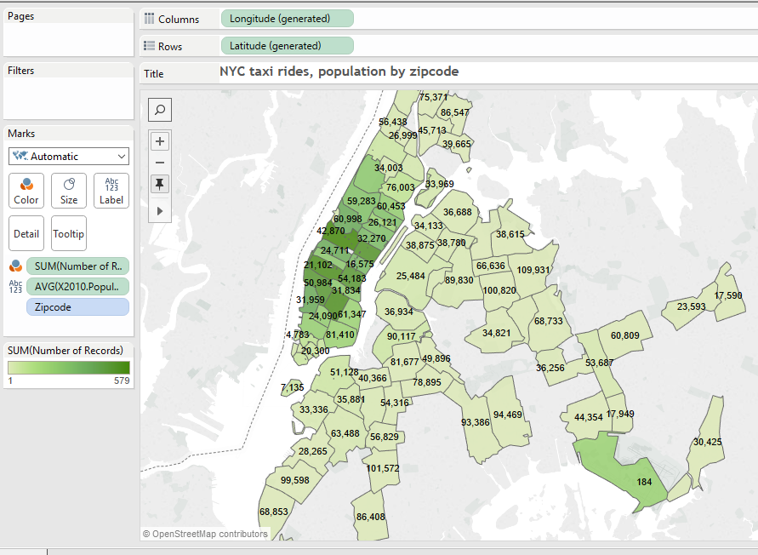
Wait in the right area

Slide 9
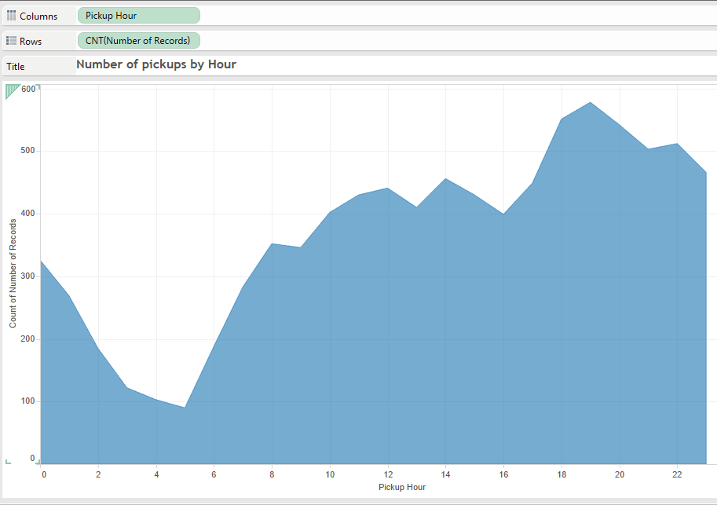
...at the right time
Notes:
This graph doesn’t have legend, not title

Slide 10
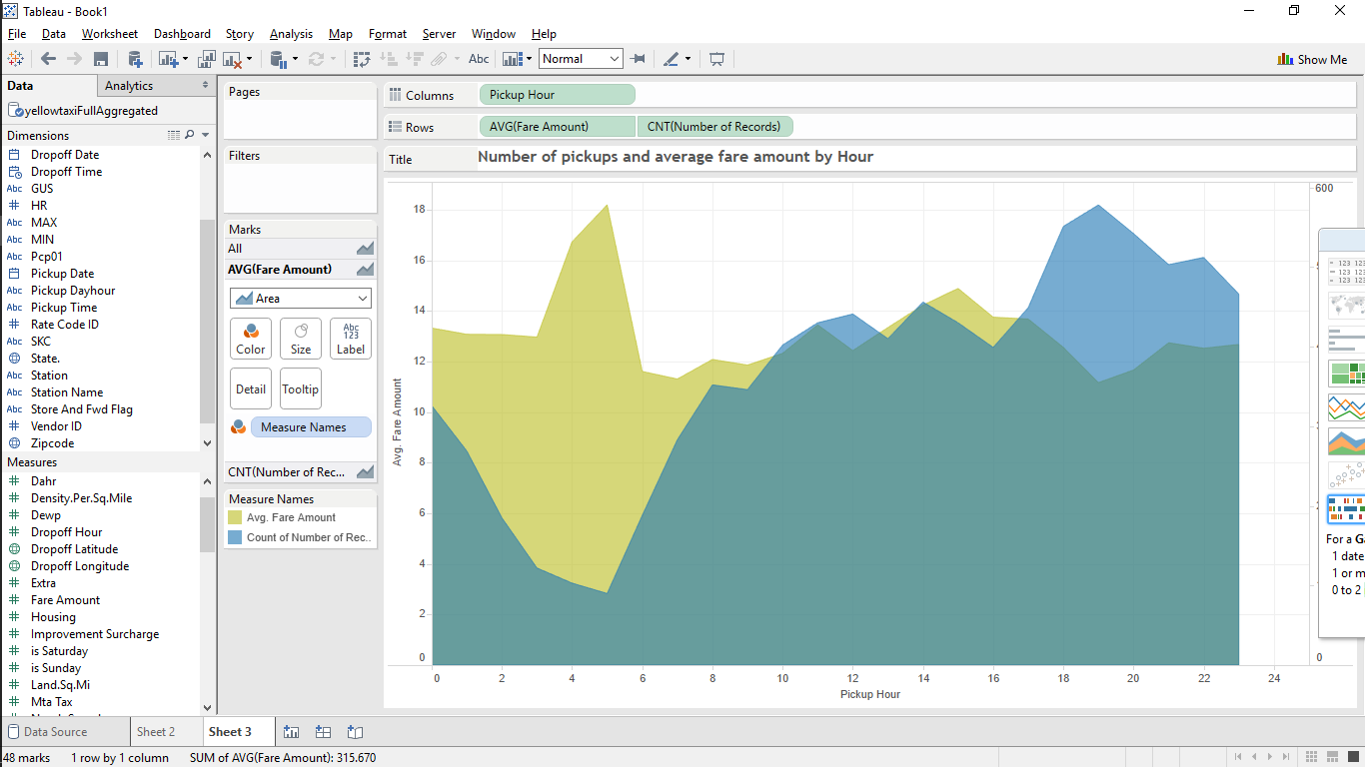
However...
Avg Fare Amount
Volume

Slide 11
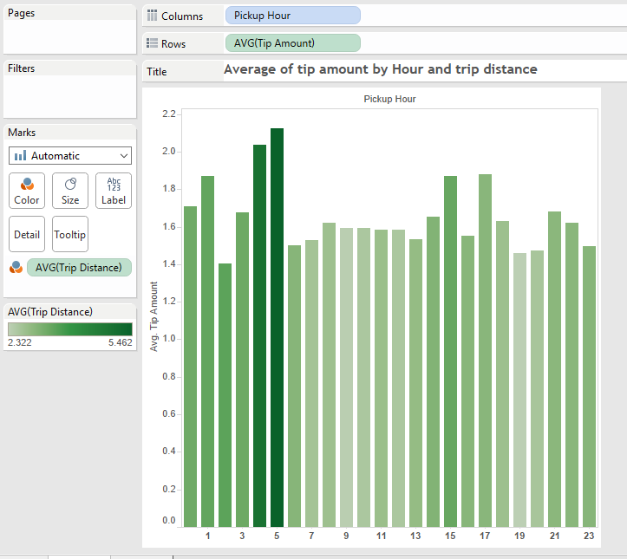
...and what about tip?
Avg Tip
The early bird catches the worm

Slide 12
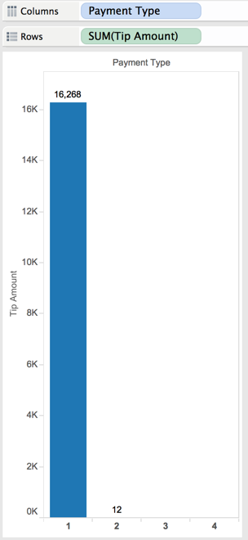
And maybe in the end you should dump your credit card machine ;)
Tip amount from credit card payment = $16,268
Tip amount from cash payments = $12

Slide 13
Proof of relationship
Grouped the dataset by hour
Dependent variable: number of taxi(Demand)
Independent variable: specific hour (3 to 5 hour True)
Correlation: Highly correlated between two variable
Analysis the power of Linear model
Number of taxi = 437.71 - 318.05 * (3 to 5 hour True)
P value is smaller than 0.05, this is valid
R squared is 0.5528 which means moderate strong model

Slide 14
Proof of relationship
Grouped the dataset by hour
Dependent variable: average fare
Independent variable: specific hour(4 to 5 hour True)
Correlation: Highly correlated between two variable
Analysis the power of Linear model
Average taxi fare = 16.3289 + 5.2393 * (4 to 5 hour True)
P value is smaller than 0.05, this is valid
R squared is 0.6504 which means moderate strong model

Slide 15
Insights from linear regression
In the rainy and windy day, people don’t like to go out, so there are not many people who want to ride a taxi.
Neighborhood :
Asian and hispanic people don’t ride a taxi many times.
Unemployment is not correlated.
Number of taxi(Demand) by day and hour
Coefficients:
Estimate Std. Error t value Pr(>|t|)
(Intercept) 368.44304 45.97584 8.014 1.3e-08 ***
prcp -0.31330 0.09465 -3.310 0.00265 **
Temp -0.12973 0.15746 -0.824 0.41720
wind_speed -4.33419 1.83549 -2.361 0.02568 *
---
Signif. codes: 0 ‘***’ 0.001 ‘**’ 0.01 ‘*’ 0.05 ‘.’ 0.1 ‘ ’ 1
Residual standard error: 34.2 on 27 degrees of freedom
Multiple R-squared: 0.4098, Adjusted R-squared: 0.3442
F-statistic: 6.249 on 3 and 27 DF, p-value: 0.002314
Total fare by zipcode
Coefficients:
Estimate Std. Error t value Pr(>|t|)
(Intercept) 2716.0740 565.9529 4.799 6.14e-06 ***
pctasian -31.5442 10.7528 -2.934 0.00423 **
pctwhite -1.4233 9.3788 -0.152 0.87971
pcthispanic -62.3770 20.5438 -3.036 0.00312 **
pctblack 0.1489 0.8012 0.186 0.85299
---
Signif. codes: 0 ‘***’ 0.001 ‘**’ 0.01 ‘*’ 0.05 ‘.’ 0.1 ‘ ’ 1
Residual standard error: 2189 on 92 degrees of freedom
Multiple R-squared: 0.1919, Adjusted R-squared: 0.1568
F-statistic: 5.463 on 4 and 92 DF, p-value: 0.0005434

Slide 16
Dear Matt,
Take a vacation when is
Rainy and windy
Work crazy around
Midtown Manhattan or airports at 3-5am Remember
Total fare - strongly correlated by neighborhood.
Best regards,
Entrepreneurship team

Slide 17
Thank you
©Team entrepreneur-sheep

Slide 18
Appendices

Slide 19
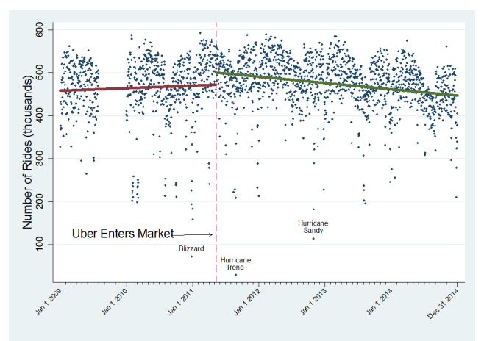
Daily Taxi Trips (in thousands)

Slide 20
Explain Linear programming model
Send your taxi to the place(Zipcode) which has the high average fare
Decision variable: number of taxi in a Zipcode area
Constraints: actual demand of taxi in a Zipcode area
Objective function: Maximize revenue = ∑(average fare in a Zipcode area × number of taxi in a Zipcode area)
Maybe we can show the excel file to show how it works.

Slide 21
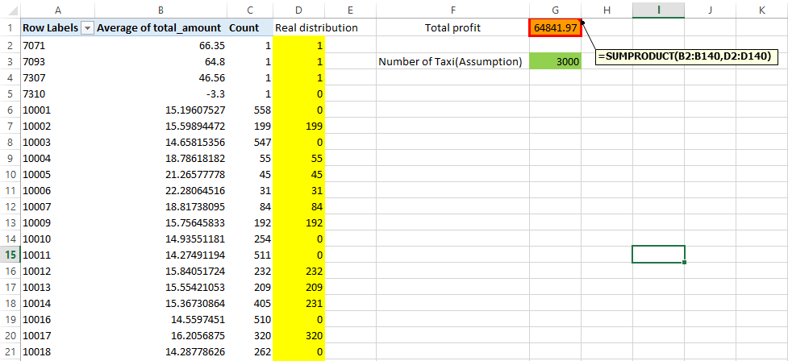
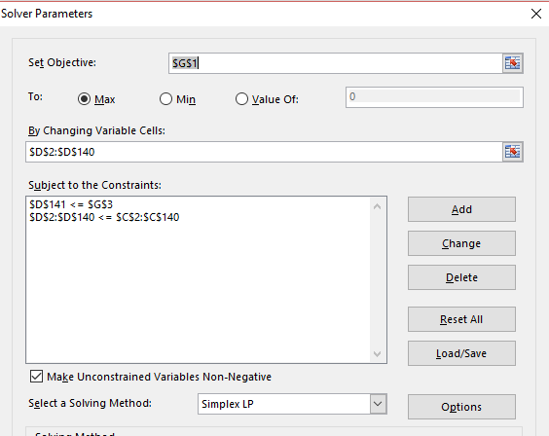
Explain Linear programming model

Slide 22
Explain Precondition
Zipcode has relation with the taxi fare => Using Chi-Square test to see association
We can predict the number of taxi(demand) in specific time(1 hour) => Using Linear model to predict the number of taxi
We can predict average taxi fare in specific time(1 hour) => Using Linear model to predict average taxi fare
The following formula might be better to attach on appendix. (I think not many people could understand easily at once)
Predict The number of taxi in 1 day by weather variable
Predict the rate of taxi in 1 hour Rate1 = The number of taxi in 1 hour/Sum of the number of taxi in every hour (Sum of the number of taxi in every hour != 1 day)
Modified 1 hour demand = 1 day × Rate1
Predict the average fare in 1 hour Rate2 = Average fare in 1 hour / average fare in total sample data Modified Average fare in one Zipcode = Average fare in one Zipcode × Rate2

Slide 23
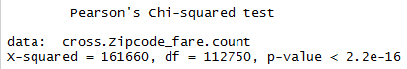
Chi Square test
Explain the outcome of Chi-Square test between Zipcode and the taxi fare
P-value is under 5%, it means there is association between Zipcode and the taxi fare

Slide 24
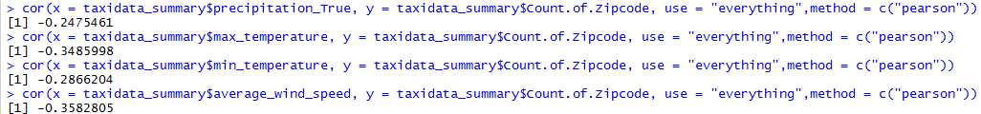
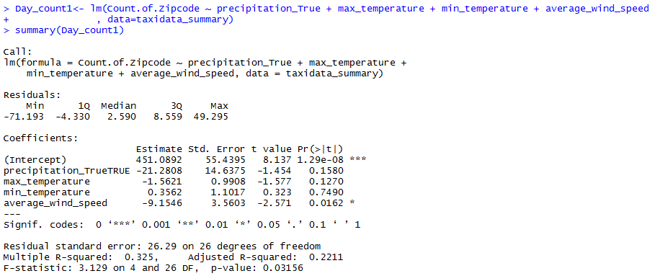
Explain Linear model-1
Grouped the dataset by day
Dependent variable: number of taxi
Independent variable: weather(wind speed, temperature,
Correlation(we can add a graph if want)
Formula of Linear model: what works(wind speed) and what doesn’t
Analysis the power of Linear model
R squared is 0.325 which means weak model

Slide 25
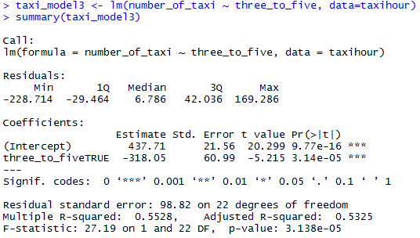
Explain Linear model-2
Grouped the dataset by hour
Dependent variable: number of taxi
Independent variable: hour
Correlation (we can add a graph if want) Highly correlated between two variable
Analysis the power of Linear model
Number of taxi = 437.71 - 318.05 * (3 to 5 hour True)
P value is smaller than 0.05, this is valid
R squared is 0.5528 which means moderate strong model

Slide 26
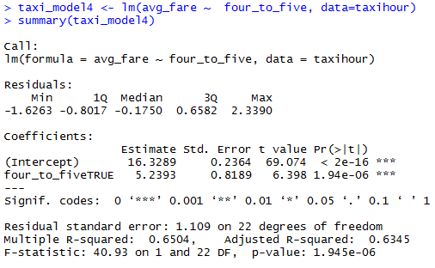
Explain Linear model-3
Grouped the dataset by hour
Dependent variable: average fare
Independent variable: hour
Correlation(we can add a graph if want) Highly correlated between two variable
Analysis the power of Linear model
Average taxi fare = 16.3289 + 5.2393 * (4 to 5 hour True)
P value is smaller than 0.05, this is valid
R squared is 0.6504 which means moderate strong model

Slide 27
Improvement Point
Because population was too big and it takes a lot of time to convert latitude and longitude to Zipcode, it is hard to analyze by only 10,000 sample in May 2015. When we tried to analyze by grouping, the number of group and the number of row per group was small.

Slide 28
Index: TLC Dataset
VendorID
Pickup_date
Pickup_Time
Dropoff_date
Dropoff_time
Passenger_count
Trip_distance
Pickup_longitude
Pickup_latitude
RateCodeID
Store_and_fwd_flag
Dropoff_longitude
Dropoff_latitude
Payment_type
Fare_amount
Extramta_tax
Tip_amount
Tolls_amount
Improvement_surcharge
Total_amount

Slide 29
Index: NOAA Dataset
STATION
STATION_NAME
DATE
PRCP
SNWD
SNOW
TMAX
TMIN
AWND

Slide 30
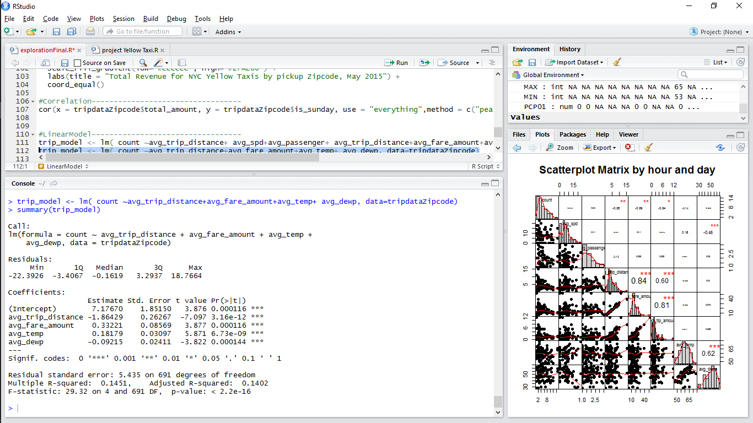
Insights from linear regression
By day and hour
By zipcode
unemprate 1.797e-02 2.852e-03 6.301 3.14e-10 ***
avg_trip_distance -1.256e-02 4.787e-03 -2.623 0.00872 ** X
asian -4.217e-03 1.037e-03 -4.067 4.82e-05 ***
white 4.613e-03 6.900e-04 6.685 2.49e-11 ***
hisp -1.624e-02 2.321e-03 -6.997 2.87e-12 ***
avg_temp 2.229e-03 1.132e-03 1.969 0.04901 * X
Signif. codes: 0 ‘***’ 0.001 ‘**’ 0.01 ‘*’ 0.05 ‘.’ 0.1 ‘ ’ 1
Residual standard error: 0.6063 on 6752 degrees of freedom
Multiple R-squared: 0.0271, Adjusted R-squared: 0.02523
F-statistic: 14.47 on 13 and 6752 DF, p-value: < 2.2e-16

Slide 31
